Slide 1
10 Productivity Tools in 10 20 Minutes
He/Him - John Morehouse He/Him - Rob sewell

Slide 2
10 Productivity Tools in 10 20 Minutes
He/Him - John Morehouse He/Him - Rob sewell

Slide 3
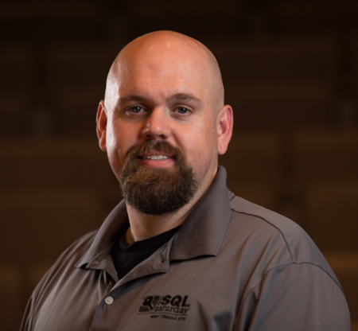
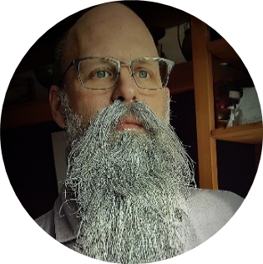
Contestants
John
Rob

Slide 4
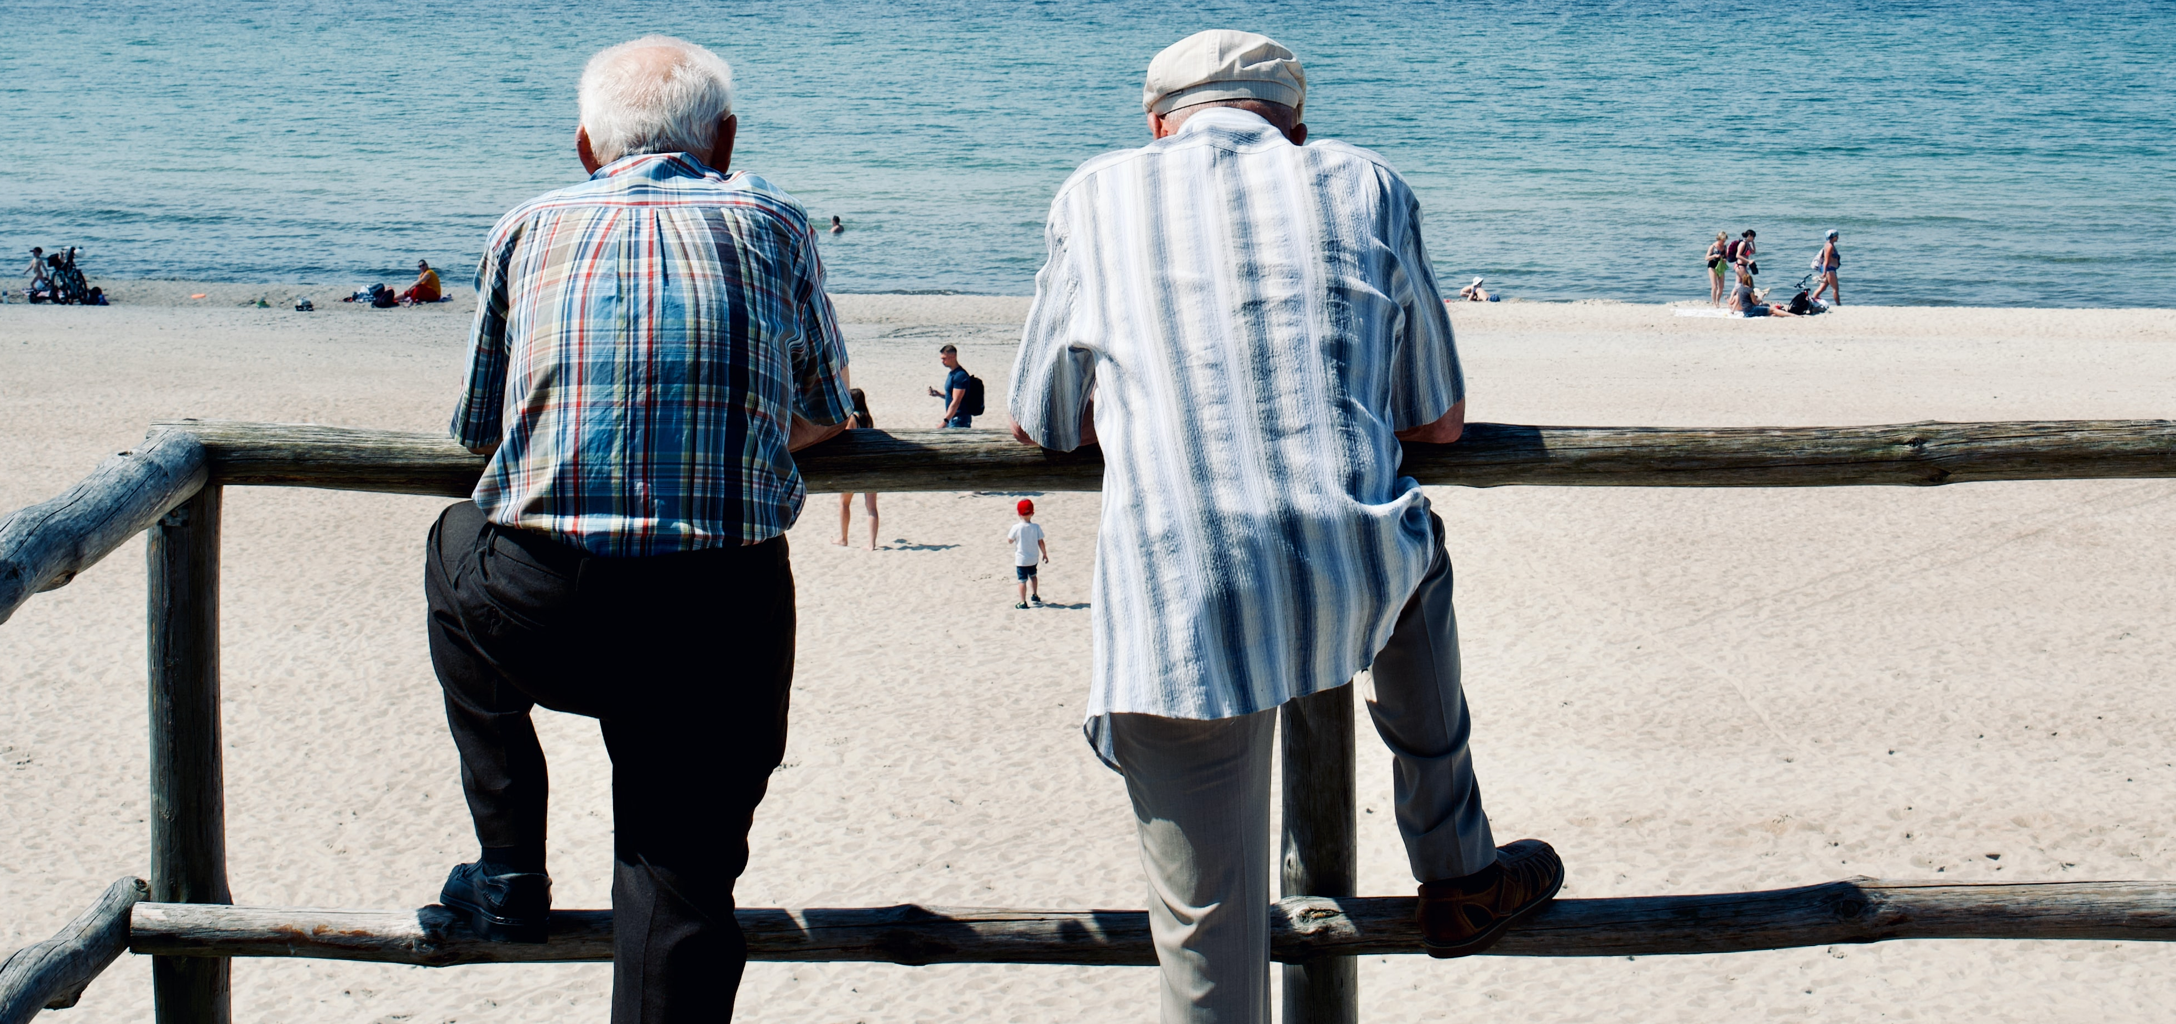
Photo by Ricardas Brogys on Unsplash
Notes:
You can see that our beards are grey. So we are old. We are both consultants, working with various clients. We both love automation.
These are some of the tools that we use to make our lives easier.
If you wish to skip to the details – you can find them here
Happy with a beard.media link ?

Slide 5
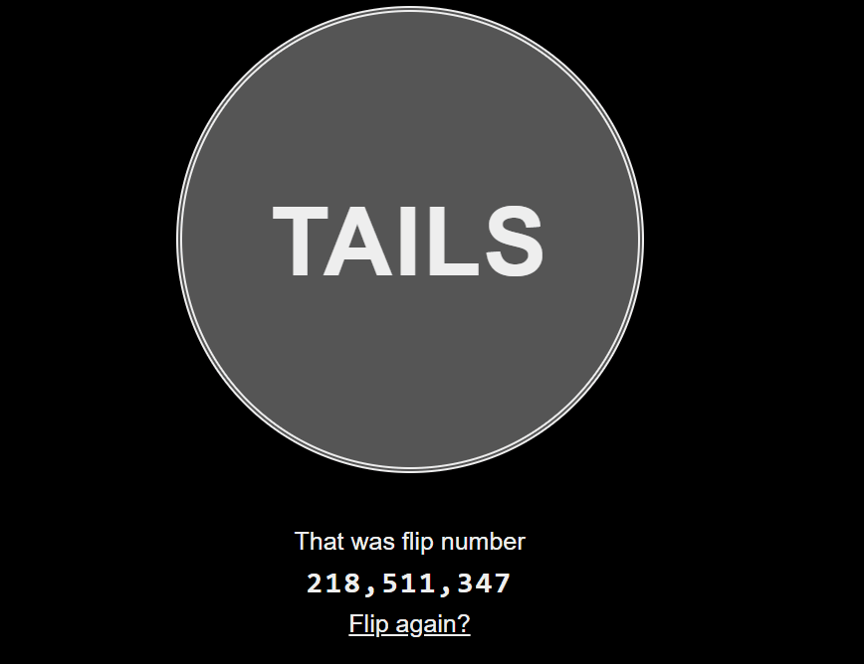
90
80
40
30
20
10
ScreenToGif
Notes:
John
(this is a great example)
Love it – tell the story and describe the use case ?

Slide 6

beard.media/productivitytools
90
80
40
30
20
10
Notes:
Rob
Homebrew for mac

Slide 7
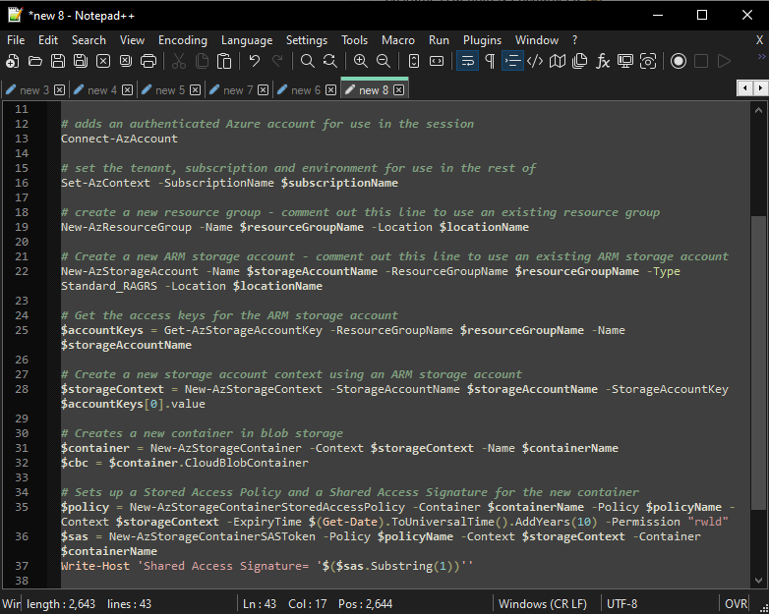
beard.media/productivitytools
90
80
40
30
20
10
Notepad++
Notes:
John
File editing
XML plugins
Macros
Multi-line editing capabilities
Syntax color coding

Slide 8
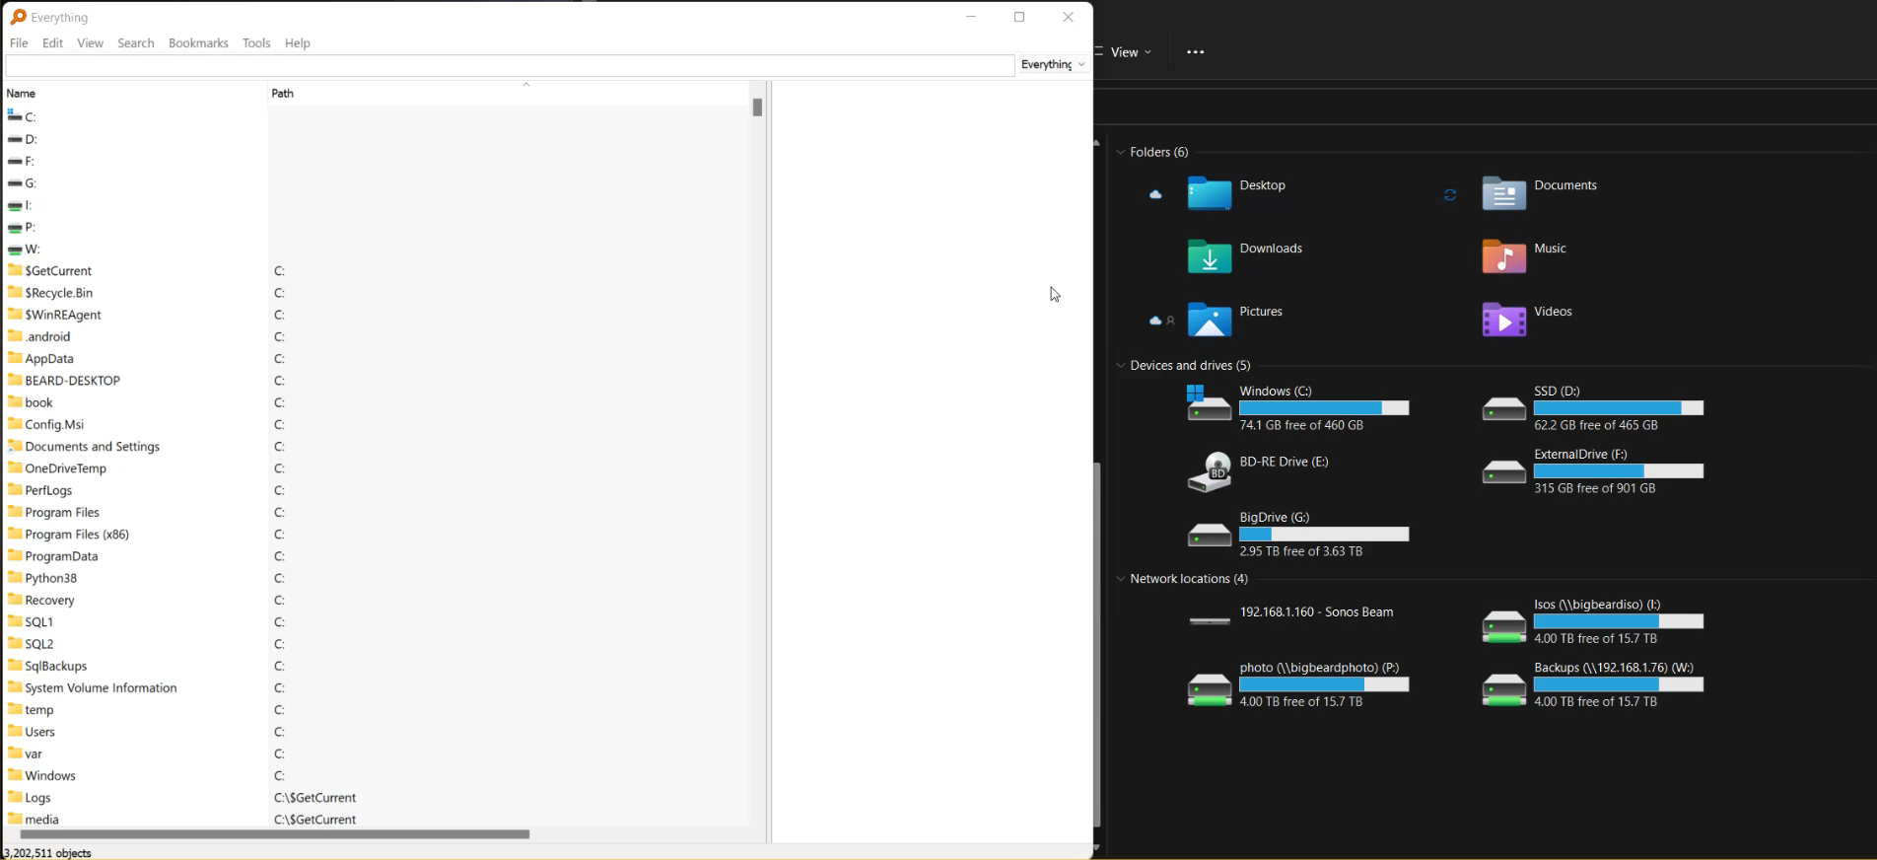
beard.media/productivitytools
90
80
40
30
20
10
Everything
Notes:
Rob
Search on Windows is slow. I use Everything from void tools to search everything on my machine and my mapped drives from my NAS. Everything is super blazing frightenly quick. It does it by using the underlying NTFS Master File Table. It has a really small memory footprint and PowerShell functions. Makes finding files realy quick and simple (unlike Windows .....)
How is Everything different from other search engines
Small installation file.
Clean and simple user interface.
Quick file indexing.
Quick searching.
Quick startup.
Minimal resource usage.
Small database on disk.
Real-time updating.

Slide 9
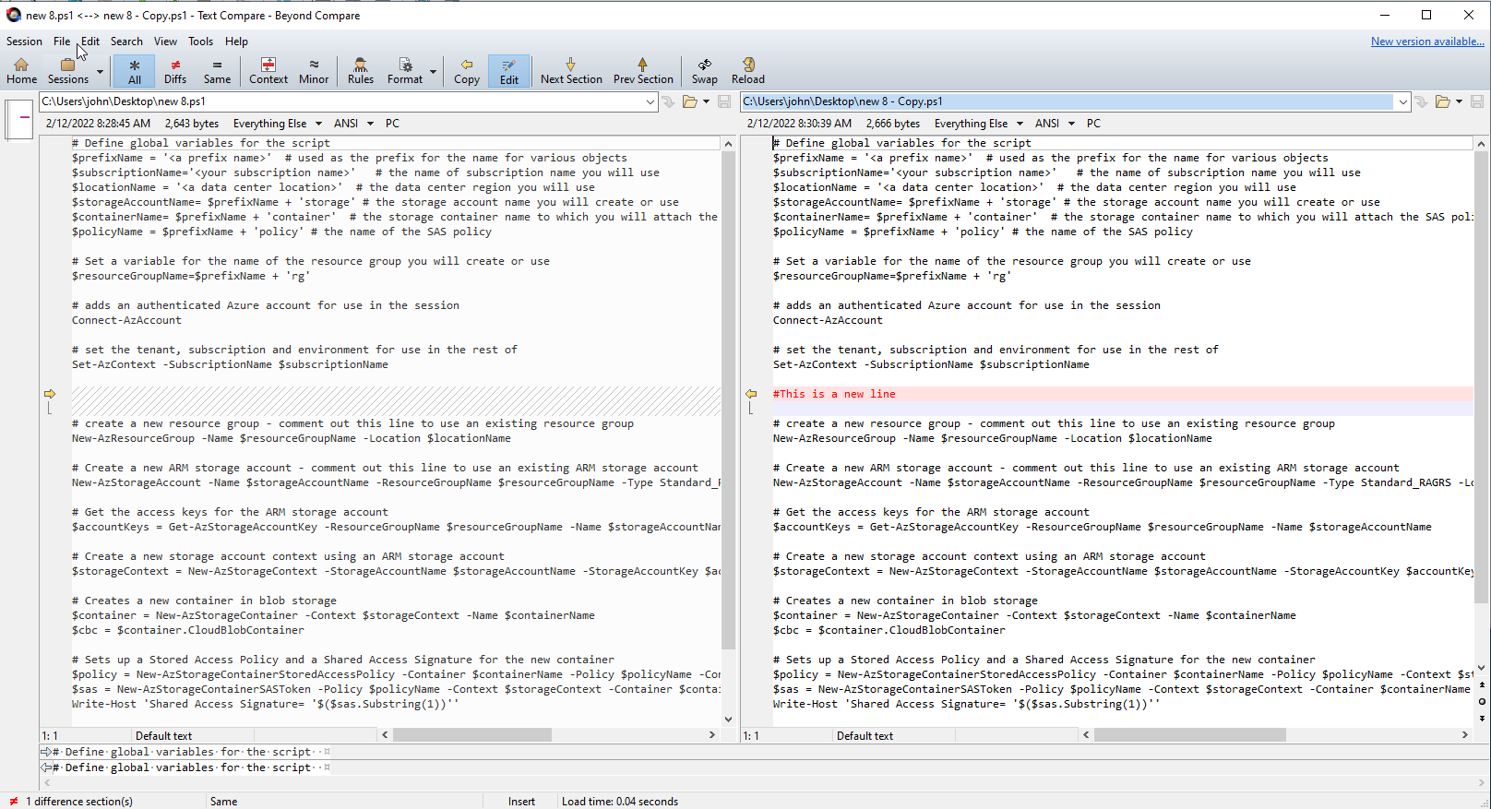
beard.media/productivitytools
90
80
40
30
20
10
Beyond Compare
Notes:
John
$60 for standard license
Compare text files
Compare folder contents
Easily identify differences

Slide 10
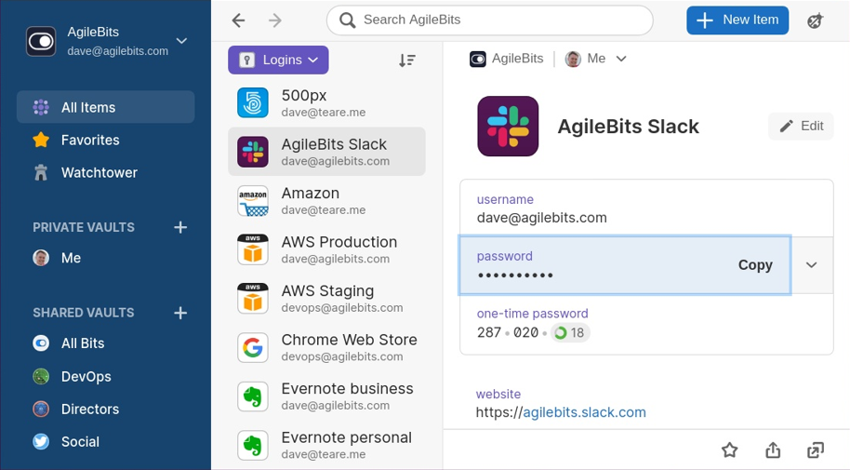
beard.media/productivitytools
90
80
40
30
20
10
1Password
Notes:
John
WatchTower
HIBP’d
International Traveler
Shared Vaults
Family Plans (see shared vaults)
Image source: https://frunction.com/2020/08/1password-linux-development-beta/ licensed under https://creativecommons.org/licenses/by-nc-sa/4.0/

Slide 11
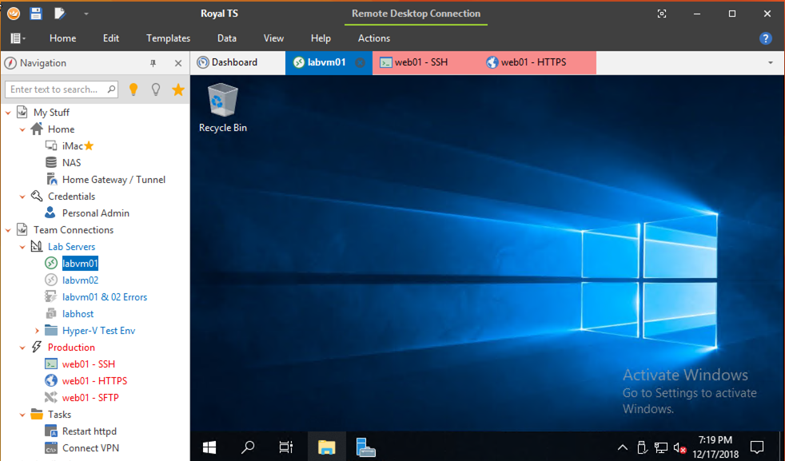
beard.media/productivitytools
90
80
40
30
20
10
RoyalTS
Notes:
John
Folders
RDP into stuff (client folder structure)
SSH ability
Credentials storage
Syncable (IE dropbox/onedrive)

Slide 12
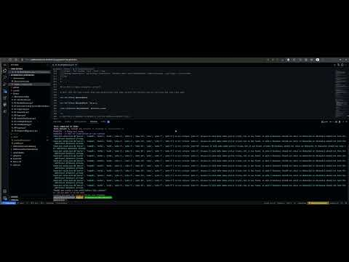
beard.media/productivitytools
90
80
40
30
20
10
Notes:
Rob - Github

Slide 13
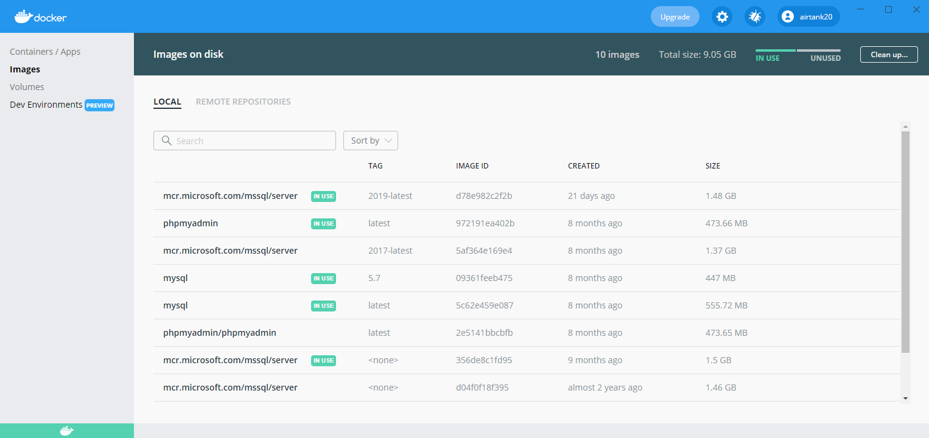
beard.media/productivitytools
90
80
40
30
20
10
Docker
Notes:
John
Easily standup environments locally
Quick SQL box

Slide 14
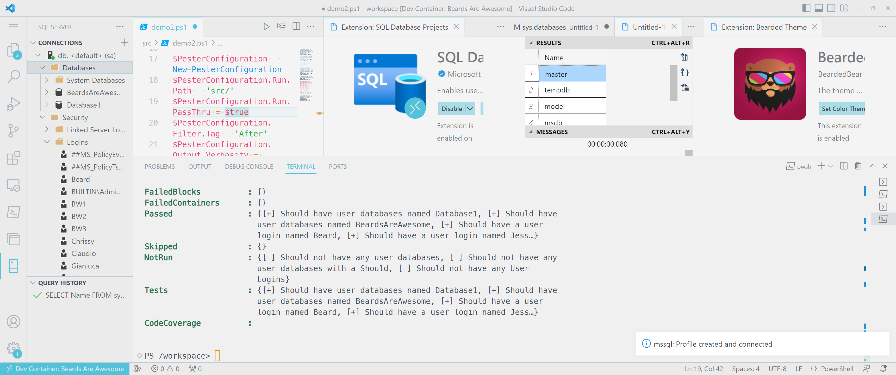
beard.media/productivitytools
90
80
40
30
20
10
Visual Studio Code
Insert screen shot of it doing a load of things which can run whilst I talk
Notes:
Rob
VS Code, does so much – all the languages, all the comparing, docker, bicep, dev containers, source control

Slide 15


Slide 16


Slide 17
90
80
70
60
50
40
30
20
10
Countdown main – mess with it here and copy pasta

